Slide 1

AI IMPACT ON JOBS -2030
Submitted By
NANDANA C V

Slide 2
INTRODUCTION
Artificial Intelligence is transforming the job market by automating routine tasks and increasing productivity across industries. While some jobs may be replaced by AI by 2030, many new roles will emerge that require digital, analytical, and creative skills. Understanding AI’s impact on jobs is essential to prepare the workforce for future opportunities and challenges.

Slide 3
OBJECTIVES OF THE STUDY
To analyze the impact of AI on employment
by 2030
To identify jobs at risk due to automation
To study new job opportunities created by AI
To understand skill changes required for the
future workforce
To evaluate sector-wise impact of AI on jobs

Slide 4
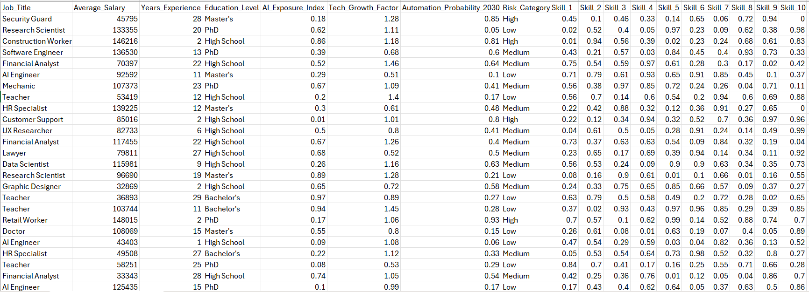
DATASET

Slide 5
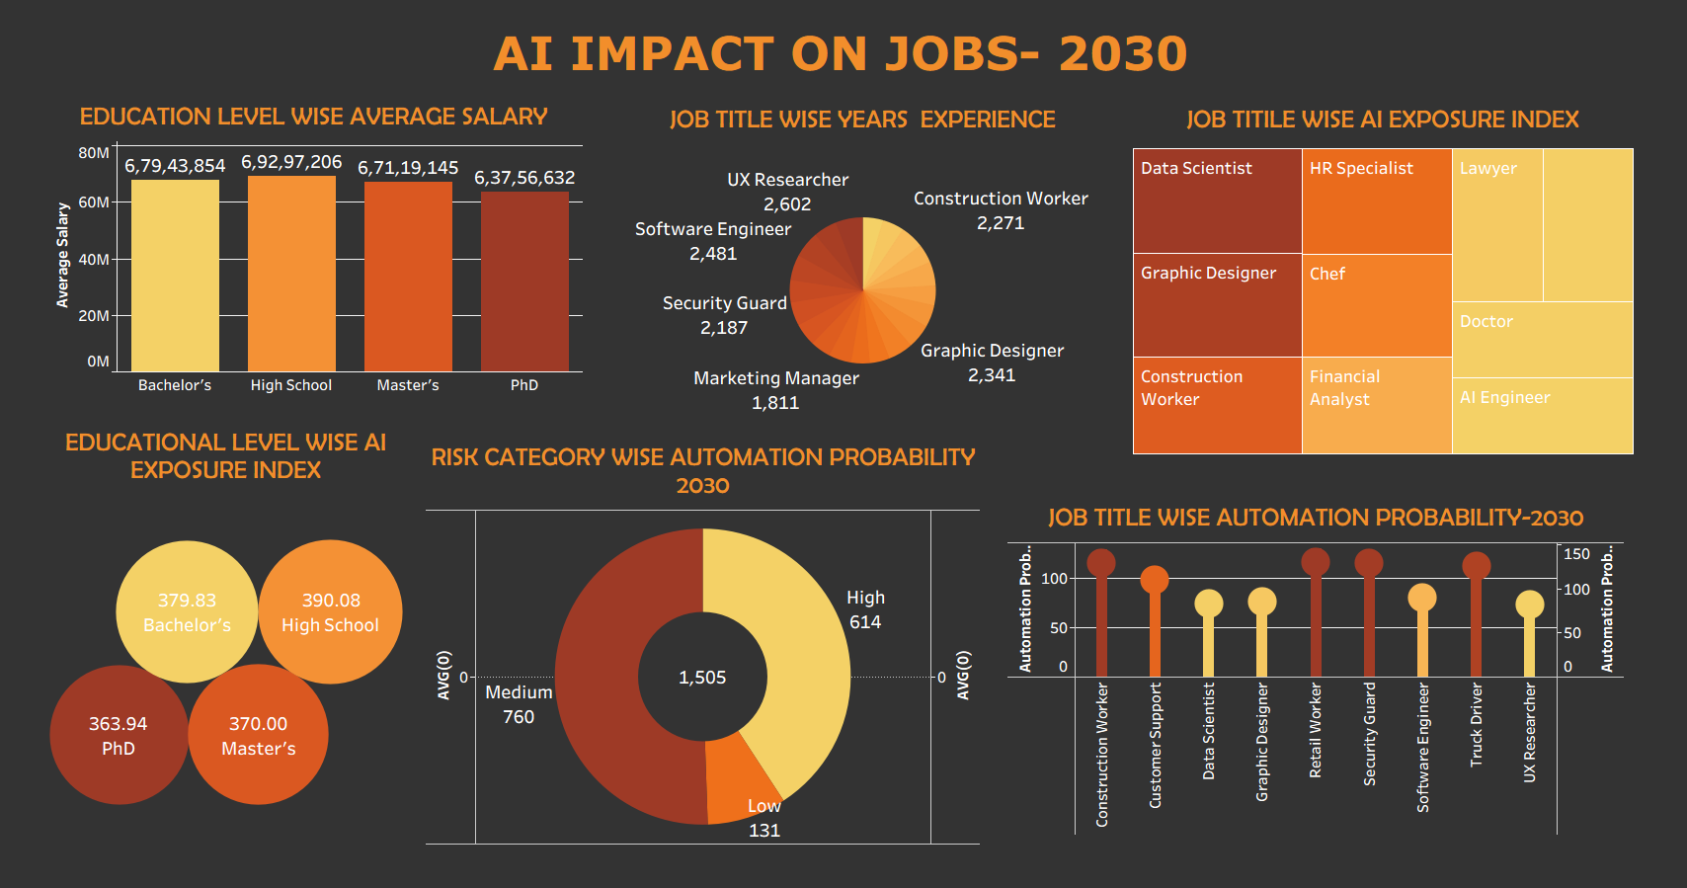
DASHBOARD

Slide 6
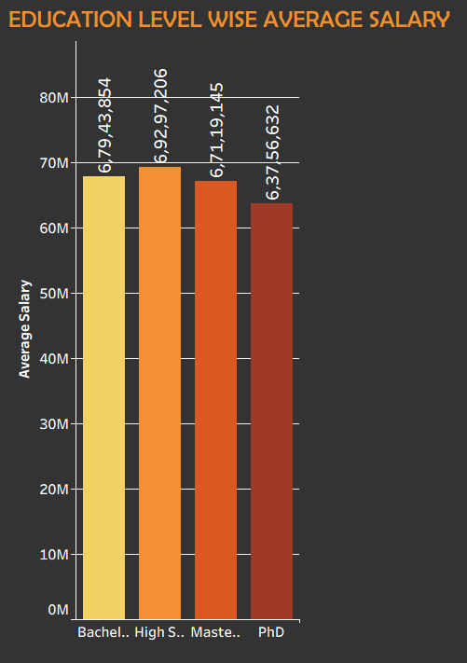
BAR CHART
Compare values between categories.
High School level shows the highest average salary.
Bachelor’s and Master’s have similar salary ranges.
PhD has the lowest average salary in this data.

Slide 7
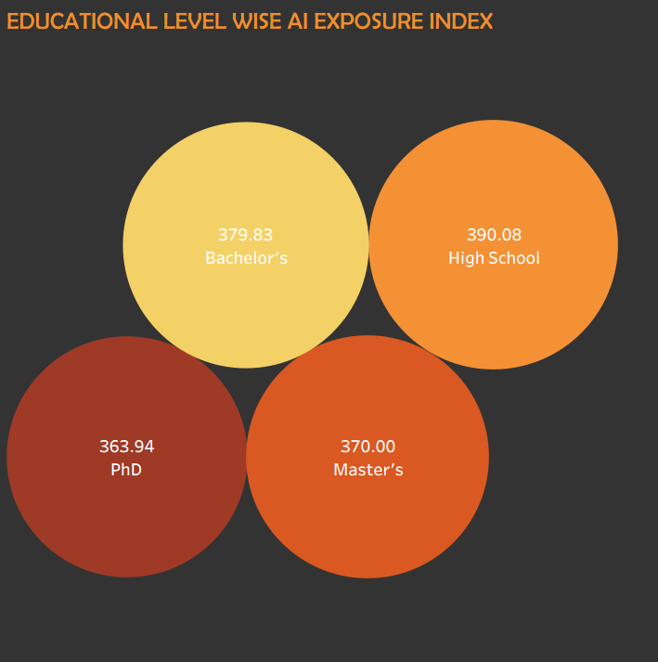
BUBBLE CHART
Visualize 3 dimensions of data (X, Y, and size).
High School has the highest AI exposure.
AI exposure decreases with higher education.
PhD has the lowest AI exposure.

Slide 8
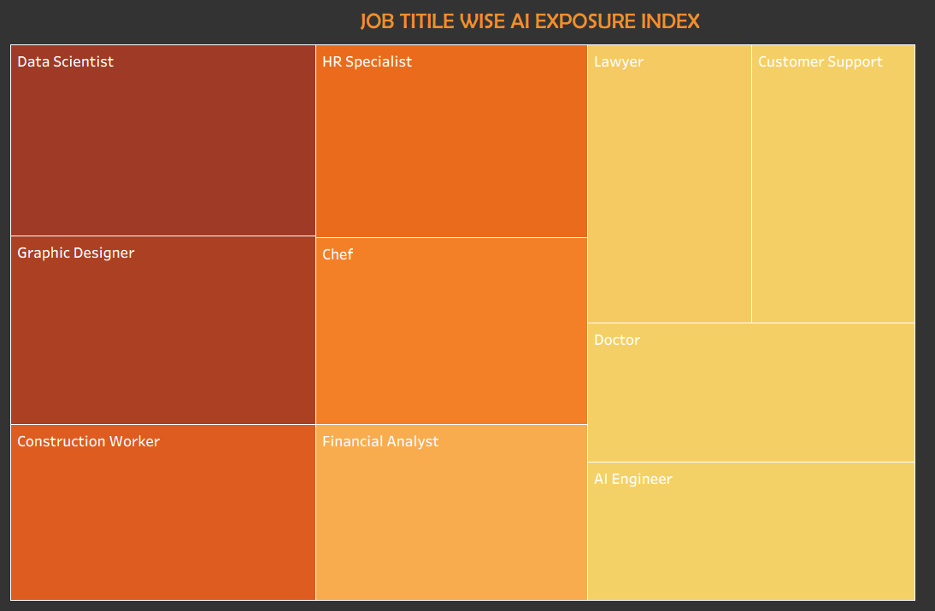
TREE MAP
Show hierarchical data
Data Scientist and Graphic Designer have high AI exposure.
HR Specialist and Construction Worker have medium AI exposure.
Doctor and Lawyer have low AI exposure.

Slide 9
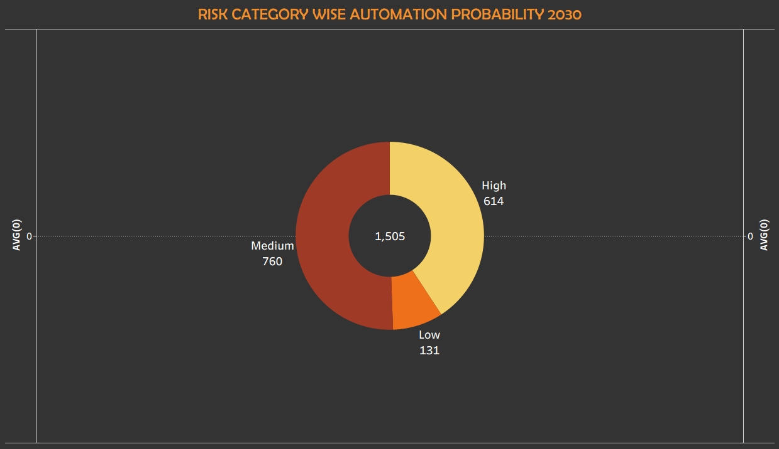
DONUT CHART
Percentage(Stylish version of pie)
Most jobs fall under the medium risk category.
A large portion is also in the high-risk group.
Very few jobs are in the low-risk category.

Slide 10
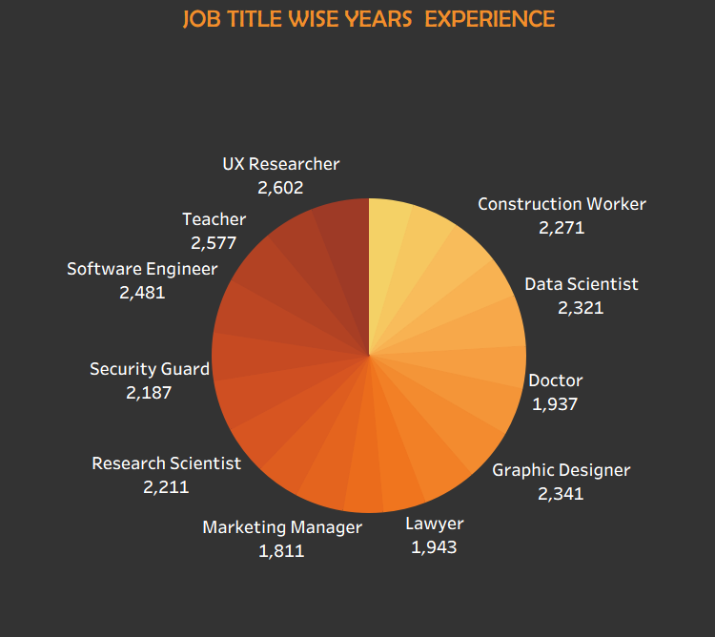
PIE CHART
Show percentage(part of whole)
UX Researchers and Teachers have the highest experience.
Software Engineers and Designers also show high experience.
Marketing Managers and Doctors show comparatively lower experience.

Slide 11
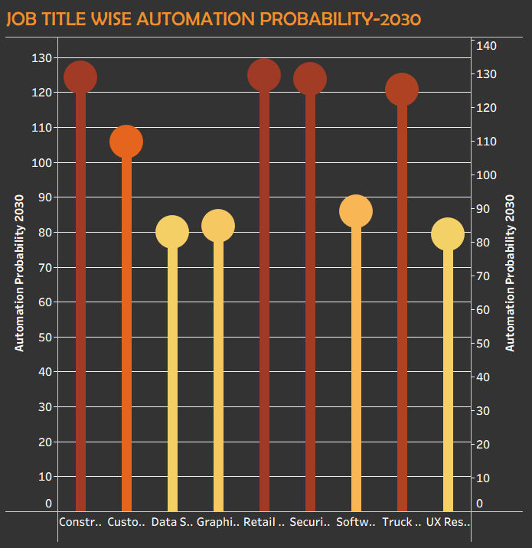
LOLLIPOP CHART
Compare categories (Cleaner than Bar)
Construction, retail, and security jobs have the highest automation risk.
Customer support and truck driving are also highly at risk.
Tech and design roles show medium risk.

Slide 12
FINDINGS
Majority of jobs show medium exposure to AI automation
Repetitive and routine roles face higher automation risk
Skilled and knowledge-based jobs remain more secure
AI is mainly reshaping tasks, not eliminating jobs
Upskilling and reskilling improve future job stability

Slide 13
CONCLUSION
AI will transform jobs, not fully replace them
Most roles face medium automation risk
Repetitive jobs have higher AI impact
Skilled and creative jobs are more resilient
Upskilling is essential for future careers
AI increases productivity and efficiency
Job roles will evolve by 2030

Slide 14
THANK YOU

